Slide 1


TU Final Defense on Medicine Recommendation System
Presented By:
Naresh khatri (6-2-530-20-2020)

Slide 2
Table of Contents
Introduction
Problem Statement
Objects
Scope
Literature review
Functional requirements
Non functional requirements
Use case diagram
Feasibility study
Tools and technology
Diagrams
Algorithm Details
Result Analysis
Conclusion
References

Slide 3
Introduction
Medicine recommendation refers to the process of using algorithms to suggest appropriate medications for a patient based on various inputs such as their symptoms
It use Support Vector machine to predict the disease and recommend the related medicine, workout e.t.c

Slide 4
Problem of statement
The Medicine Recommendation System, developed using Machine Learning, aims to improve personalized medicine by analyzing patient symptoms
This system improves treatment accuracy, efficiency, and reduces the risk of adverse drug reactions.
It continuously learns from historical data, refining its recommendations over time, and supporting healthcare providers in making informed decisions.

Slide 5
Objectives
To predict the disease on the basic of the Symptoms.
To recommend the medicine, workout, diet on the basic of the symptoms.

Slide 6
Scope
The system will be designed to analyze user-inputted symptoms and predict potential diseases using machine learning algorithms
The system will suggest appropriate medications based on the predicted disease(s) to address the individual's specific condition.

Slide 7
Limitations
It is mainly focus in backend rather than UI
System may not 100% accuracy.
System may not respond to all symptoms.

Slide 8
Methodology
Develop the system using Bootstrap, CSS and JavaScript for frontend and python and datasets for backend.
This project adopted agile technique
Use SVM algorithm.

Slide 9
Literature Review
1.Diagnosis-based recommendation systems
Recommend appropriate medications based on diagnostic data (e.g., disease names, lab results).
Diagnostic data such as disease names, symptoms, and lab results.
Random Forest: A model that predicts the appropriate medication based on features in the diagnostic data.
The system learns optimal prescriptions through trial and feedback. [1]

Slide 10
Continued…
2. Adverse drug interaction prediction systems
Identify and avoid harmful combinations of medications to ensure patient safety.
Collaborative Filtering: Predict potential drug interactions based on historical data of similar cases (used in recommendation systems).[2]

Slide 11
Functional Requirements
The user shall be able Enter the symptoms.
The users shall be able to view disease.
User shall be able to view about disease description.
The user shall able to know about the medicine.
User shall be able to know about the workouts.
User shall be able to know about the diets.
User shall be able to view the precaution.

Slide 12
Non-functional Requirements
The system must be user-friendly.
The system must provide recommendations quickly.
The system must be compatible with different system devices.

Slide 13
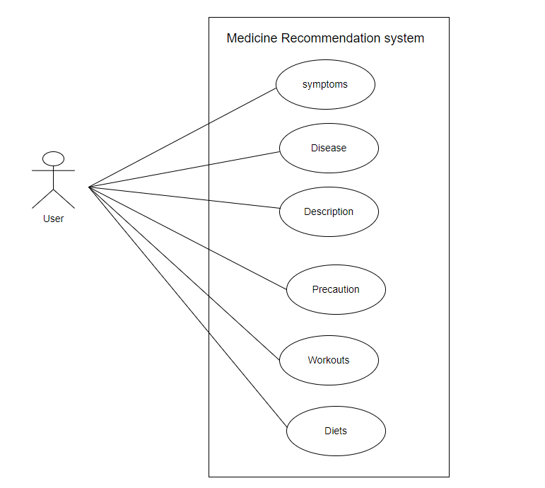
Use Case Diagram

Slide 14
Feasibility study
Technical Feasibility
Support Vector Classifier (SVC) with a linear kernel. This is the algorithm that was initialized, trained, and used for prediction and recommendations.
Libraries like sk-learn in Python provide efficient implementations of support Vector Classifier, accuracy-score, confusion-matrix.

Slide 15
Feasibility study
Operational Feasibility
The system is a web based app so it is platform independent.
The system will have an simple and intuitive UI so it will be easy to understand and use

Slide 16
Economic Feasibility
There are no development costs as the data is free on sites like Kaggle and applying the algorithm is also free.

Slide 17
Schedule Feasibility

Slide 18
Tools and Technology
Programming Languages: Python, JavaScript
Libraries and Frameworks:
sk-learn for import the model
Pandas and NumPy for data manipulation.
Bootstrap, flask for frontend and backend.
Editor and other Tools: VS Code, GitHub, Lucid Charts, Jupyter Notebook.

Slide 19
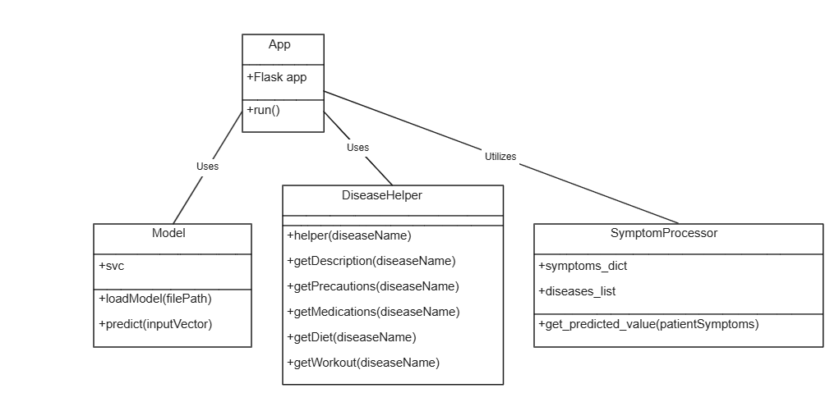
Diagrams: Class Diagram

Slide 20
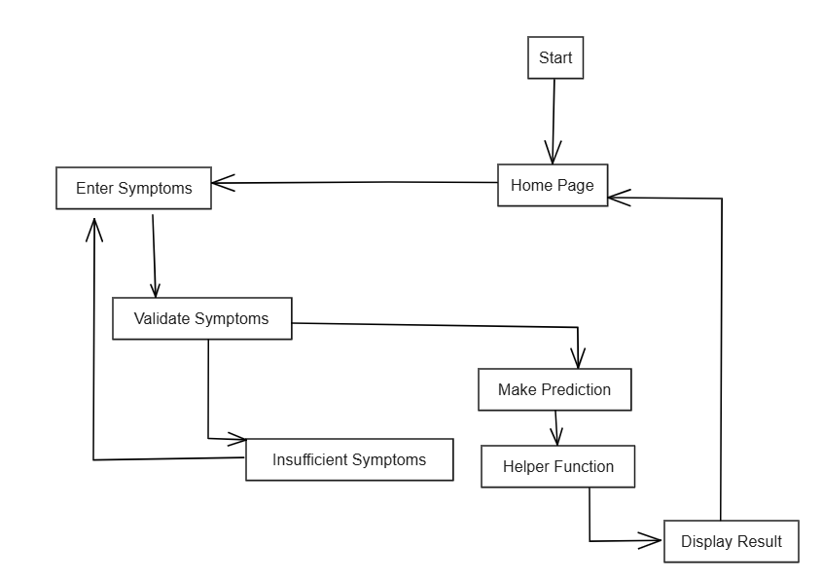
State Diagram

Slide 21
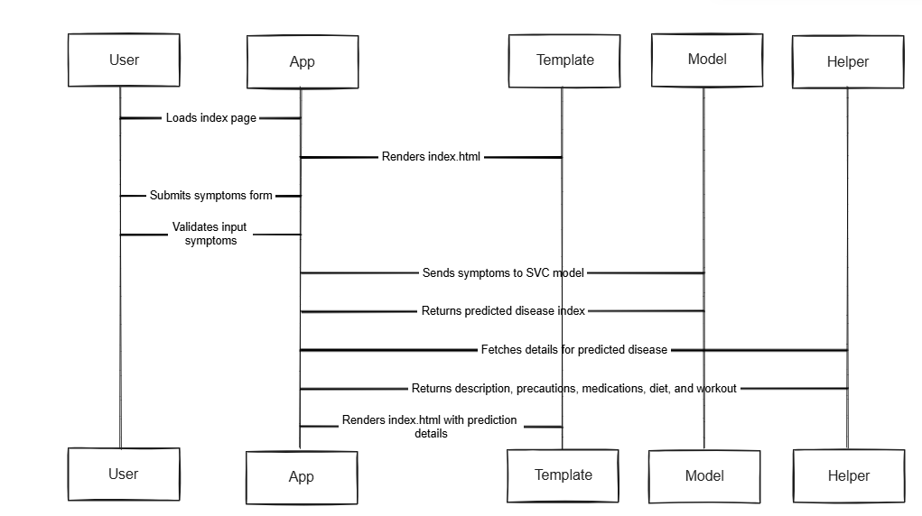
Sequence Diagram

Slide 22
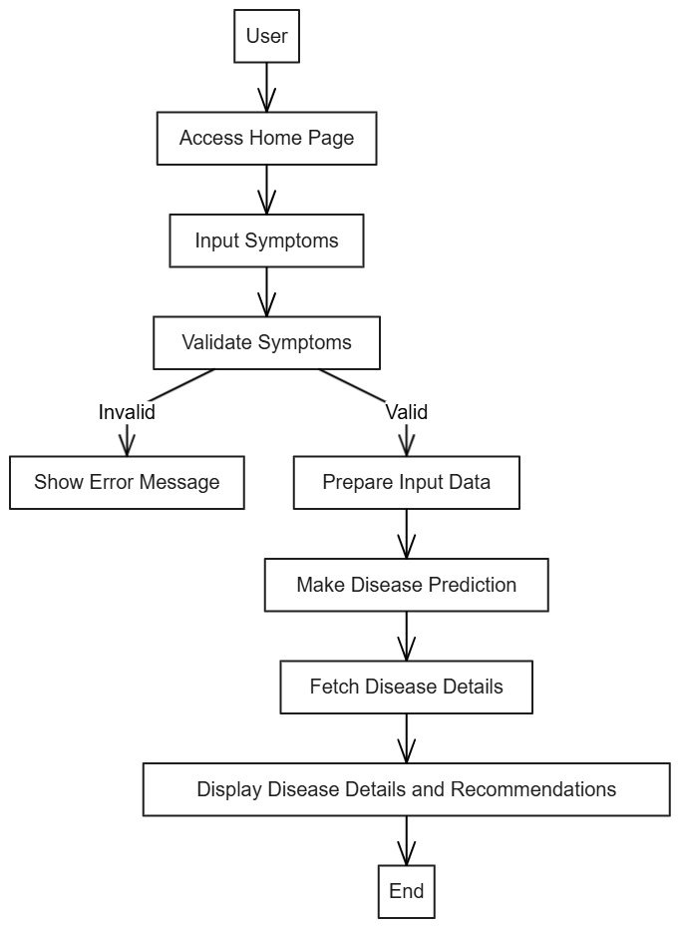
Activity Diagram

Slide 23
Algorithm Details (SVM)
A supervised machine learning algorithm used for classification and regression tasks.
Maximizes the margin between data points of different classes to enhance classification accuracy.
The algorithm tries to find the hyperplane that maximizes the margin between the classes while minimizing classification errors.
Works well with both linear and non-linear data.

Slide 24
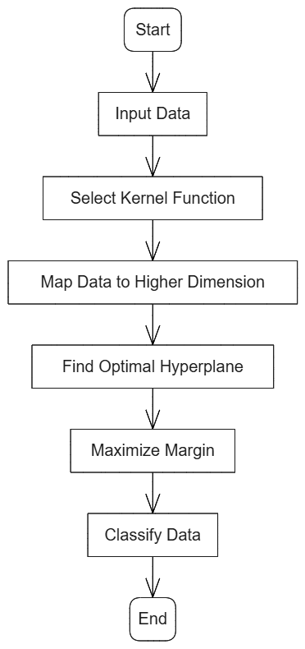
Continued…

Slide 25
Description of Algorithm
Support Vector Classification (SVC) is a specific implementation of the Support Vector Machine (SVM) algorithm used for classification tasks.
SVM tries to maximize the margin (distance between the hyperplane and the support vectors) to enhance generalization.
Linear SVM: For linearly separable data, the algorithm finds a straight hyperplane.
Classifies new data points based on which side of the hyperplane they fall on.

Slide 26
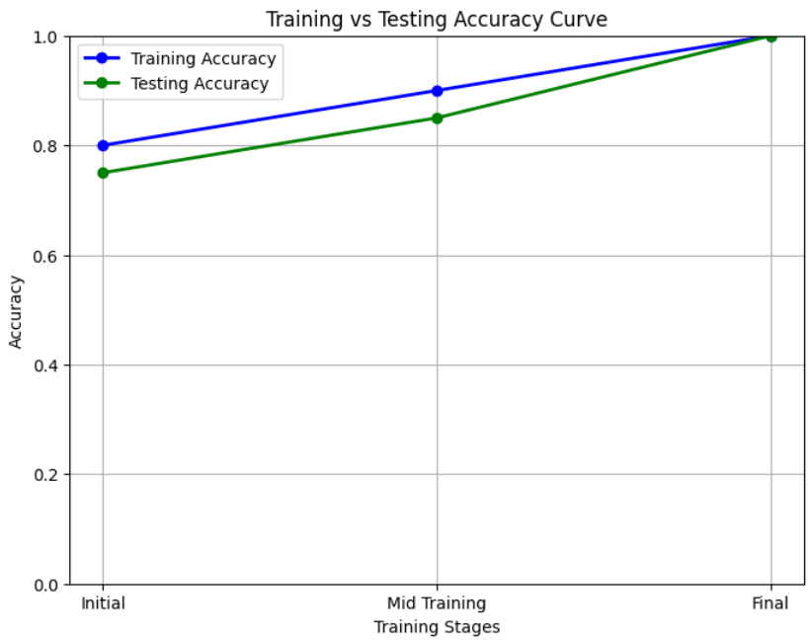
Result Analysis

Slide 27
Conclusion
Medicine recommendation systems use advanced algorithms to analyze patient data, suggesting appropriate medications, improving prescription accuracy, personalizing treatment plans, and enhancing patient care. With continuous advancements, they could lead to better patient outcomes.

Slide 28
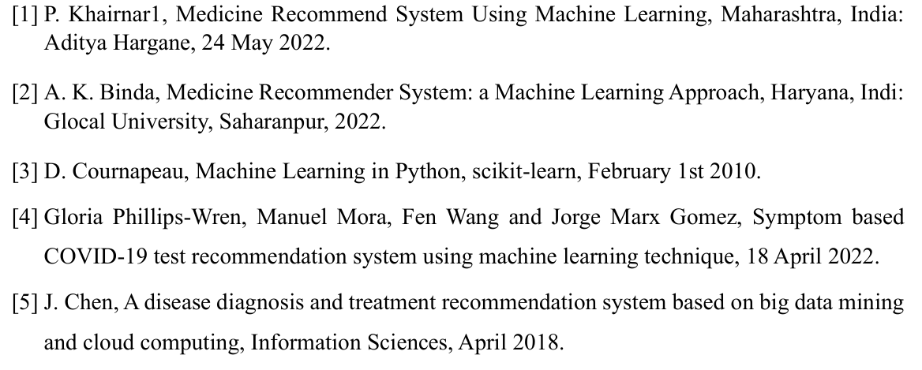
References

Slide 29
Thank You!
Any Queries?

